Slide 1
Taking inputs from the user
Group G
Prajna C
Pooja
Sandhya L

Slide 2
Command we use is read
Syntax : read <input variable>
Ex program:
read input1
echo "$input1"

Slide 3
read with -p
Syntax : read –p PROMPT <input variable>
Ex program:
read –p "Lets take an input" input1
echo "$input1"

Slide 4
read with -sp
Syntax : read –sp PROMPT <input variable>
Ex program:
read –sp "Lets take an input secretly" input1
echo "$input1"

Slide 5
read with -a
Syntax : read -a <array_name>
Ex program:
read –a "Lets take input as an array" input1
for var in $input1
do
Echo "$var"
done

Slide 6
Outputs on console
Using echo
Echo "string"
Ex:echo –e "hello \tbatch 86 \ti \tam \tinux" -
-e = Use dto detect \ and variable.
\t- = Used to add tab.
\n = Used to print output on new slide.
\v = It gives vertical tab
\b = It is used to remove spaces.
Using printf
Printf "string"
Ex:Printf "%d \n" 2.55 oxff 0324 3.5
%d = It is used to print integer value.
%f = it is used to print float value.

Slide 7
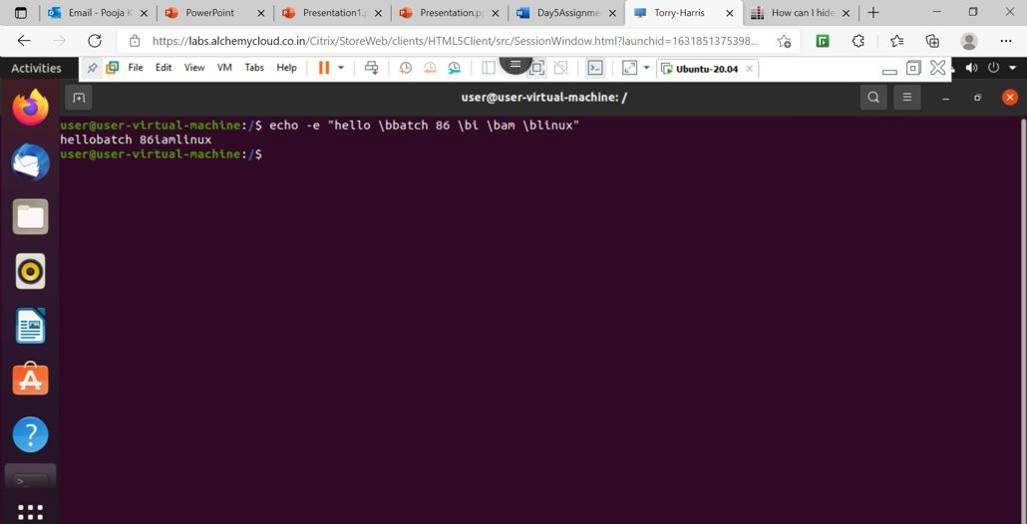

Slide 8
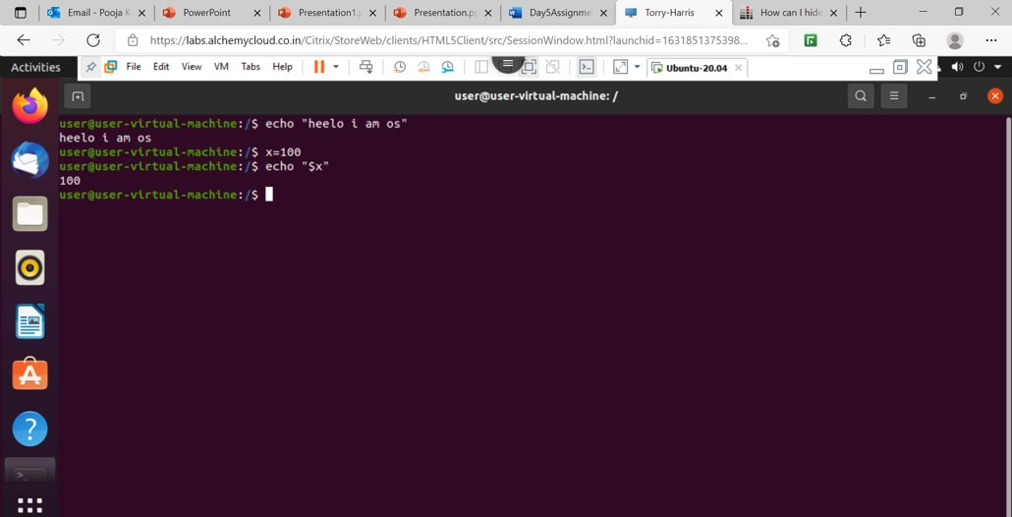

Slide 10
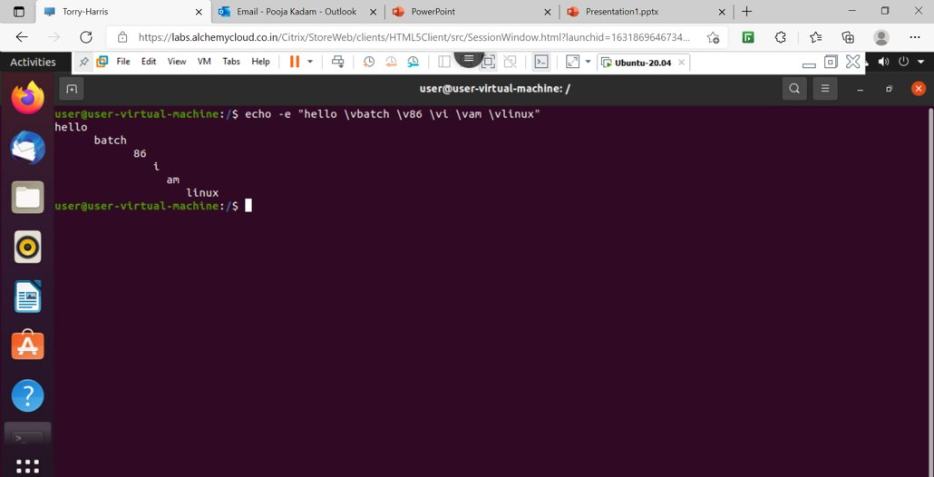

Slide 11
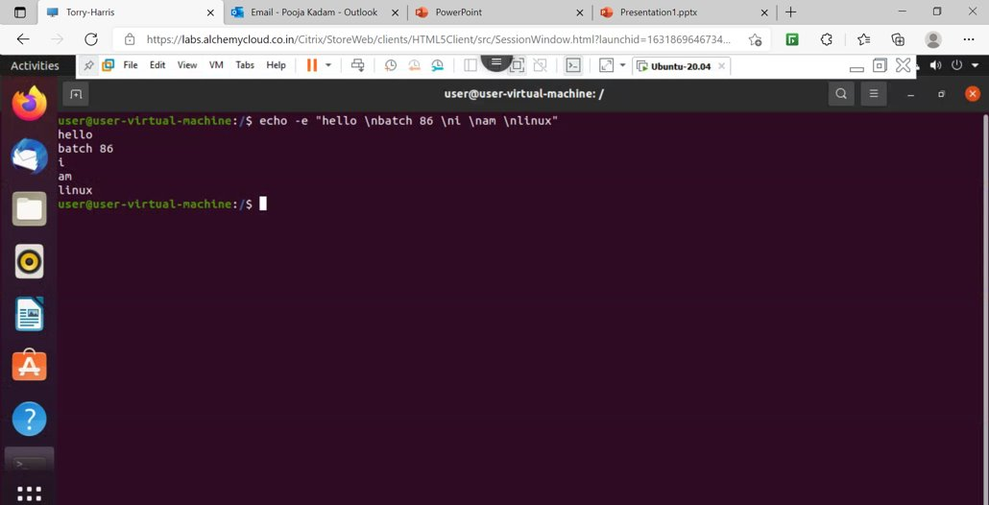

Slide 12
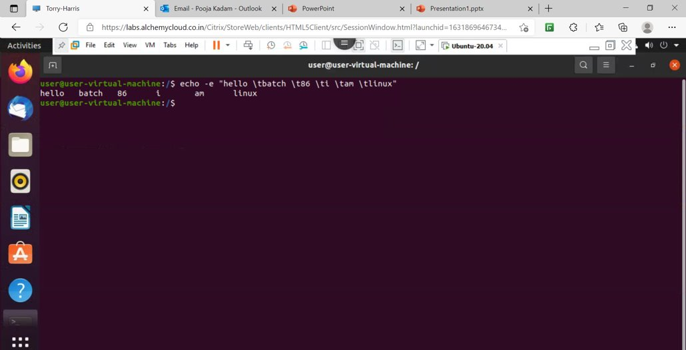

Slide 13
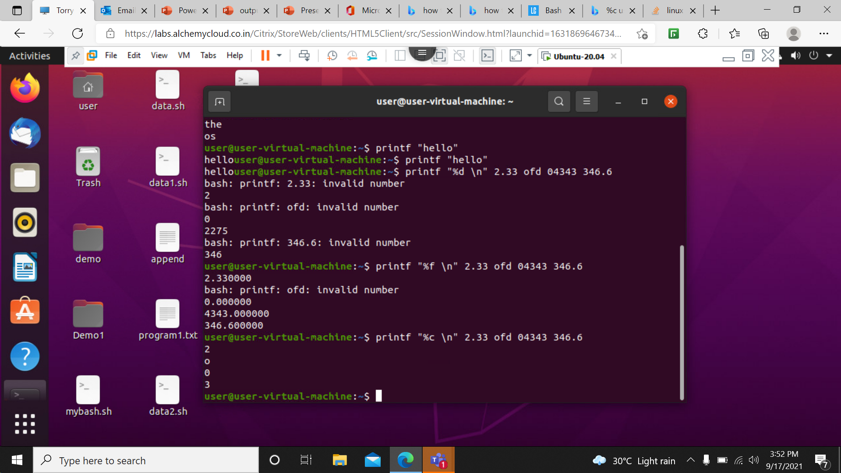

Slide 14
Printing the output on the file
Redirect Output to a File Only
To use bash redirection, you run a command, specify the > or >> operator, and then provide the path of a file you want the output redirected to.
> redirects the output of a command to a file, replacing the existing contents of the file.
>> redirects the output of a command to a file, appending the output to the existing contents of the file.

Slide 15
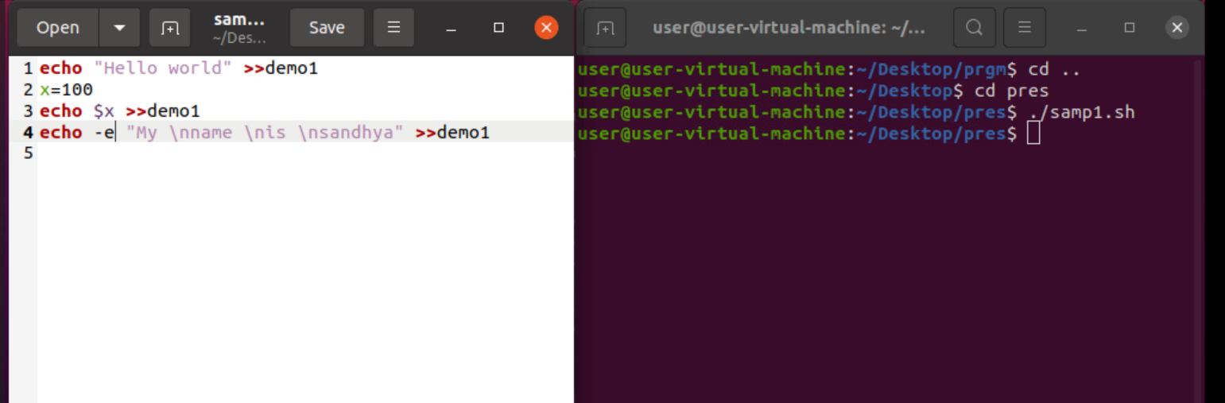
Printing the output on the file

Slide 16
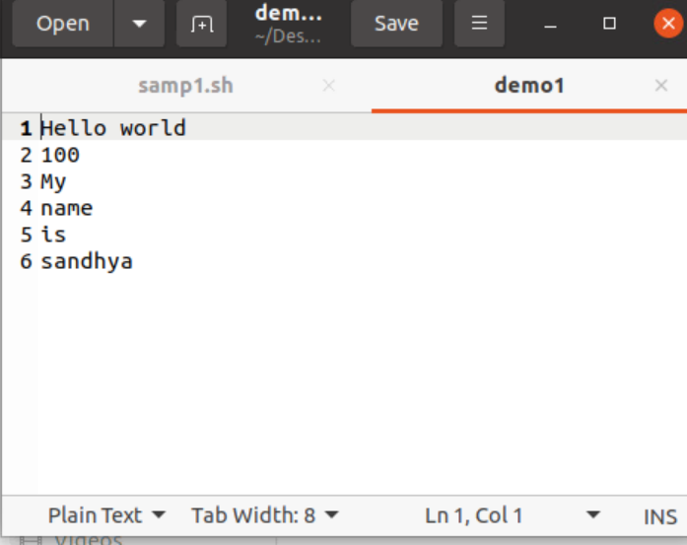
Output of Samp1.sh

Slide 17
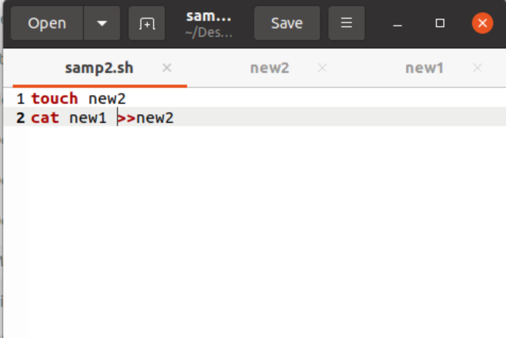
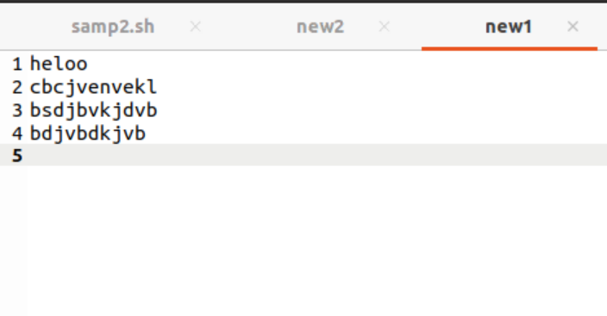
Samp2.sh
new1.txt

Slide 18
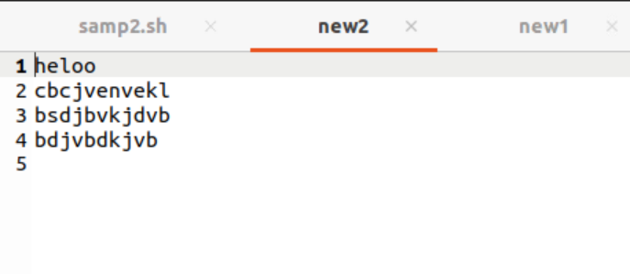

new2.txt

